Slide 1
JSF

Slide 2
JSF Overview
JSF Request Processing LifeCycle
The Facelets (Views)
Practical Lab 1
Managed Bean & Expression Language
Navigation
Practical Lab 2

Slide 3
JSF OVERVIEW

Slide 4
JSF OVERVIEW
JavaServer Faces (JSF) is a Java specification for building component-based user interfaces for web applications.
JSF is a server side user interface component framework for web-applications development in Java
It helps in designing and structuring web applications. Other Java web application frameworks includes Apache Struts, Spring.
Notes:
JavaServer Faces (JSF) is a Java specification for building component-based user interfaces for web applications.^{[1]} It was formalized as a standard through the Java Community Process and is part of the Java Platform, Enterprise Edition.
JSF 2 uses Facelets as its default templating system. Other view technologies such as XUL or plain Java^{[2]} can also be employed. In contrast, JSF 1.x uses JavaServer Pages (JSP) as its default templating system.

Slide 5
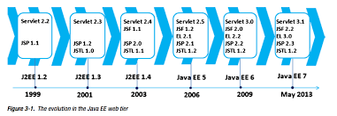
JSF History
Note :: First verison of JSF as release in 2003 . In the same year JSP 2.0 was released.
Notes:
JavaServer Faces (JSF) is a Java specification for building component-based user interfaces for web applications.^{[1]} It was formalized as a standard through the Java Community Process and is part of the Java Platform, Enterprise Edition.
JSF 2 uses Facelets as its default templating system. Other view technologies such as XUL or plain Java^{[2]} can also be employed. In contrast, JSF 1.x uses JavaServer Pages (JSP) as its default templating system.

Slide 6
JSF Versions
Versions | Release date | Description
Jsf 2.3 | 12-03-2017 | It includes major features: bean validation for complete classes, push communication using enhanced integration with cdi.
Jsf 2.2 | 21-05-2013 | It has introduced new concepts like stateless views, page flow and the ability to create portable resource contracts.
Jsf 2.1 | 22-11-2010 | It was a maintenance release 2 of jsf 2.0. only a very minor number of specification changes.
Jsf 2.0 | 01-07-2009 | It was major release for ease of use, enhanced functionality, and performance. coincides with java ee 6. JSF 2.0 does not need external AJAX jar JSF 2.X you don’t need to declare Navigation rule in “Faces-config.xml” , you just need to put page name directly in button “action” attribute JSF 2.X has support for Groovy JSF 2.X make use of Annotations like @ManagedBrean , @sessionScope
Jsf 1.2 | 11-05-2006 | It has many improvements to core systems and apis. coincides with Java ee 5. initial adoption into java ee.
Jsf 1.1 | 27-05-2004 | It was a bug-fix release. no specification changes.
Jsf 1.0 | 11-03-2004 | It was a initial specification released.
Notes:
JavaServer Faces (JSF) is a Java specification for building component-based user interfaces for web applications.^{[1]} It was formalized as a standard through the Java Community Process and is part of the Java Platform, Enterprise Edition.
JSF 2 uses Facelets as its default templating system. Other view technologies such as XUL or plain Java^{[2]} can also be employed. In contrast, JSF 1.x uses JavaServer Pages (JSP) as its default templating system.

Slide 7
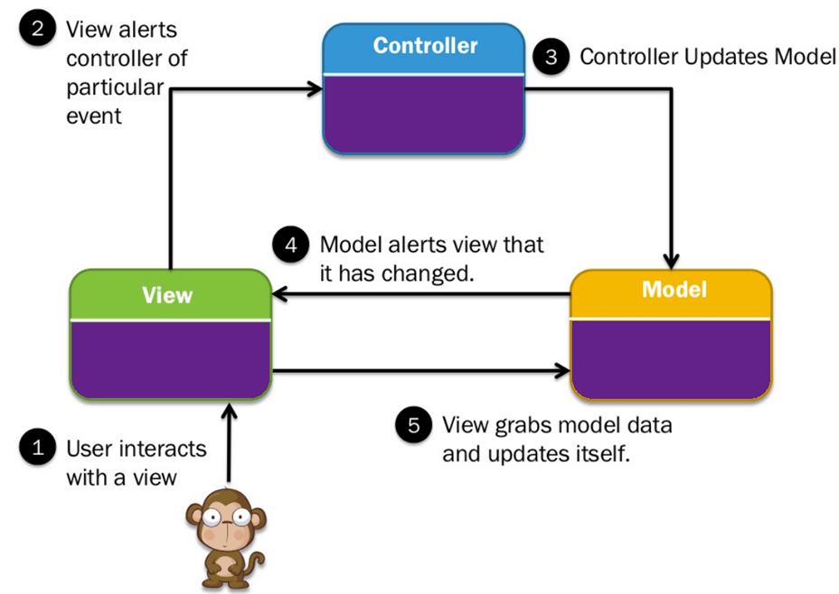
Model – View – Controller (MVC Architecture)
Model: It includes all the data and its related logic
View: Present data to the user or handles user interaction
Controller: An interface between Model and View components
Notes:
JavaServer Faces (JSF) is a Java specification for building component-based user interfaces for web applications.^{[1]} It was formalized as a standard through the Java Community Process and is part of the Java Platform, Enterprise Edition.
JSF 2 uses Facelets as its default templating system. Other view technologies such as XUL or plain Java^{[2]} can also be employed. In contrast, JSF 1.x uses JavaServer Pages (JSP) as its default templating system.

Slide 8




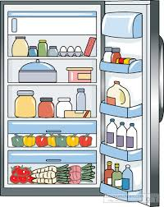
MVC Architecture contd ..
Menu = You
Waiter = Controller
Cook = Model
Refrigerator = Data
Notes:
JavaServer Faces (JSF) is a Java specification for building component-based user interfaces for web applications.^{[1]} It was formalized as a standard through the Java Community Process and is part of the Java Platform, Enterprise Edition.
JSF 2 uses Facelets as its default templating system. Other view technologies such as XUL or plain Java^{[2]} can also be employed. In contrast, JSF 1.x uses JavaServer Pages (JSP) as its default templating system.

Slide 9
Component VS Request based MVC
Component based MVC | Request based MVC
Front controller does more the delegating the request. It gather , convert and validate request parameters and update the model values accordingly. | Single Front Controller will delegate the request to Model based on URL.
User don’t need to write the boilerplate code to gather and validate the input request . | User need to write the code to gather , convert and validate the request and update the model values before invoking the business action
Less control over the process and resources like HTML,CSS,JS | More control over the process and resources like HTML,CSS,JS
Notes:
JavaServer Faces (JSF) is a Java specification for building component-based user interfaces for web applications.^{[1]} It was formalized as a standard through the Java Community Process and is part of the Java Platform, Enterprise Edition.
JSF 2 uses Facelets as its default templating system. Other view technologies such as XUL or plain Java^{[2]} can also be employed. In contrast, JSF 1.x uses JavaServer Pages (JSP) as its default templating system.

Slide 10
Why JSF?
Before JSF, JavaServer Pages (JSP) was a complimentary technology to Java Servlet which facilitates the mixing of dynamic and static web contents. But JSP have some drawbacks as listed below
JSP | JSF
JSP does not provide such facilities like validating request, converting request. | JSF supports validator and conversion, ajax, managed beans.
JSP is not a request driven model view controller, but JSP is accessed by the dynamically generated web pages like HTML or XML. | JSF is a framework. Model: Managed bean View: xhtml Controller: Facesservlet
Request based MVC | Component based MVC
Notes:
JavaServer Faces (JSF) is a Java specification for building component-based user interfaces for web applications.^{[1]} It was formalized as a standard through the Java Community Process and is part of the Java Platform, Enterprise Edition.
JSF 2 uses Facelets as its default templating system. Other view technologies such as XUL or plain Java^{[2]} can also be employed. In contrast, JSF 1.x uses JavaServer Pages (JSP) as its default templating system.

Slide 11
Why JSF? .. Contd
Also in earlier 2000 , Browsers were not so powerful to Execute client side processing . So carrying out Client side processing was considered as an expensive task .Which made Server side user Interface framework popular like JSF, Struts.
JSP took inspiration from Microsoft web development framework ASP.NET
JSF can be thought as the successor to JSP.
Notes:
JavaServer Faces (JSF) is a Java specification for building component-based user interfaces for web applications.^{[1]} It was formalized as a standard through the Java Community Process and is part of the Java Platform, Enterprise Edition.
JSF 2 uses Facelets as its default templating system. Other view technologies such as XUL or plain Java^{[2]} can also be employed. In contrast, JSF 1.x uses JavaServer Pages (JSP) as its default templating system.

Slide 12
What JSF consist of :
A set of Pages that represent MVC-style views and set of tags to add components to the web pages.
A set of managed beans (POJOs)
A application configuration resource file, which defines navigation rules and custom objects (faces-config.xml)
Deployment descriptor (web.xml)
A set of custom objects, like listeners, validators, converters.
A set of custom tags for representing custom objects on the page

Slide 13
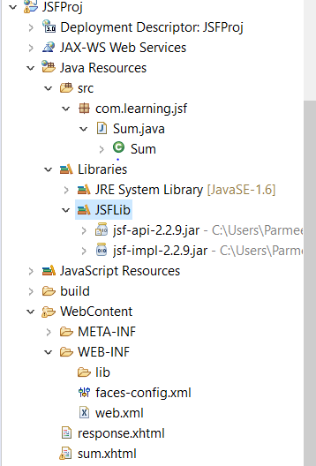
What JSF consist of :
Managed beans
Faces-config file contains the navigation rules , Managed beans information
Web.xml contains the Faces servlet mapping
Views

Slide 14
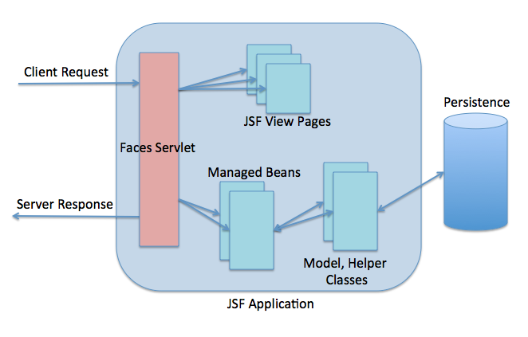
How JSF works
When a user requests a JSF page, then requests goes to Faces Servlet which act as Main Controller.
To handle user requests centrally, controller servlet navigate users to views
Model Classes/Helper classes are used to persist/fetch data from Data Base

Slide 15
Faces Servlet
FacesServlet is a servlet that manages the request processing lifecycle for web applications that are utilizing Java Server Faces to construct the user interface.
FacesServlet are configured in web.xml

Slide 16



Services/scopes handled by JSF - 1/2
Business
Services
Presentation
- Navigation - Validation - Event Handling
Controller Logic
Client Devices
JSF Framework

Slide 17
Services/scopes handled by JSF – 2/2
Model-View-Control architecture
Data conversion/validation
Managed Bean
Custom component
Renderers
Ajax
Facelets
Navigation

Slide 18
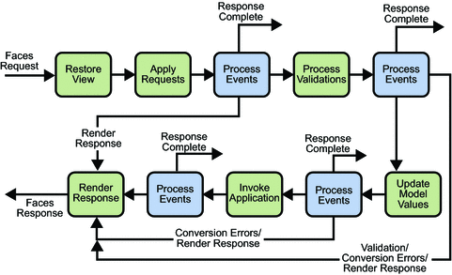
The JSF Request Processing LifeCycle

Slide 19







JEE Operating Principle
Reminder
Clients
Application Server
Containers
HTTP request
- CSS
- JavaScript
- HTML 5
Web /Servlet Container
EJB Container
HTTP response
Application Java
HTTPServletRequest
HTTPServletResponse
EJB (RMI, CORBA)
Others
JEE APIs
HTTP (REST, SOAP)
JNDI
JSF
CDI
JMS
JPA
JTA
JDBC
JAX-WS
JACC
JAAS
….

Slide 20








JSF & JEE Mechanisms
Overview
Taglib.xml
Taglib.xml
HTTP
Faces Servlet
Renderer
XHTML
request
Component
Component
HTTP
Component
Converter
response
Component
Validator
Faces-config.xml

Slide 21





JSF – Inside view
Component:
Component-Type
Renderer-Type
TagLib.xml Faces-Config.xml
Renderer
UIViewRoot
Renderer
Renderer
Component
Renderer
XHTML
Component
Renderer
Component
Renderer
Component
Renderer
HTML
Component
Component
Component
Family 1
Family 2
Renderers
Renderer-Kit
Components

Slide 22
JSF – Inside view
UIViewRoot
Component:
XHTML
Component
Component-Type
TagLib.xml Faces-Config.xml
Component
Renderer-Type
Component
Family
Component
Component
Component
HTTP request
Component
Components
HTTP response
Family 1
Renderer
Renderer
Family 2
HTML
Renderer
Renderers
Renderer
Renderer-Kit
Renderer
Renderer
Renderer

Slide 23
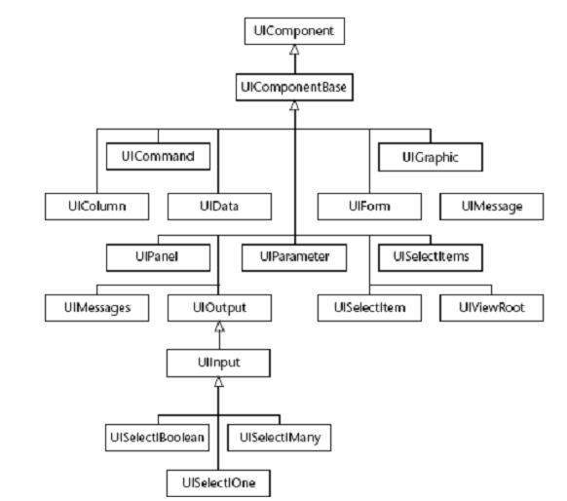
JSF Request Processing Lifecycle
The life cycle of a JSF page is somewhat similar to that of a JSP page: The client makes an HTTP request for the page, and the server responds with the page translated to HTML.
However, the JavaServer Faces life cycle differs from the JSP life cycle in that it is split up into multiple phases in order to support the sophisticated UI component model: This model requires that component data be converted and validated, component events be handled, and component data be propagated to beans in an orderly fashion.
Also JSF page is also different from a JSP page in that it is represented by a tree of UI components, called a view.

Slide 24
JSF Request Processing Lifecycle
A Process to keep in Mind
Why JSF request processing is so Important to understand ?
The request processing lifecycle serves as the “behind-the-scenes” engine that makes JavaServer Faces possible
Component-based framework vs request-based framework (JSF vs JSP/Servlet )
It is responsible for the automatic Server-Side View Management and Synchronization

Slide 25

The JavaServer Faces request Processing Lifecycle
Lifecycle schema

Slide 26
JavaServer Faces request Processing Lifecycle
The Life cycle handles two kind of request :
Initial Request
Postbacks
Initial Request :: When a user makes an initial request for a page, he or she is requesting the page for the first time.
Postbacks :: When a user executes a postback, he or she submits the form contained on a page that was previously loaded into the browser as a result of executing an initial request.

Slide 27
Restore View Phase
During this phase, the JavaServer Faces implementation builds the view of the page, wires event handlers and validators to components in the view, and saves the view in the FacesContext instance, which contains all the information needed to process a single request.
Initial request : JavaServer Faces implementation creates an empty view during this phase and the life cycle advances to the render response phase, during which the empty view is populated with the components referenced by the tags in the page.
Postback : View corresponding to this page already exists. During this phase, the JavaServer Faces implementation restores the view by using the state information saved on the client or the server.

Slide 28
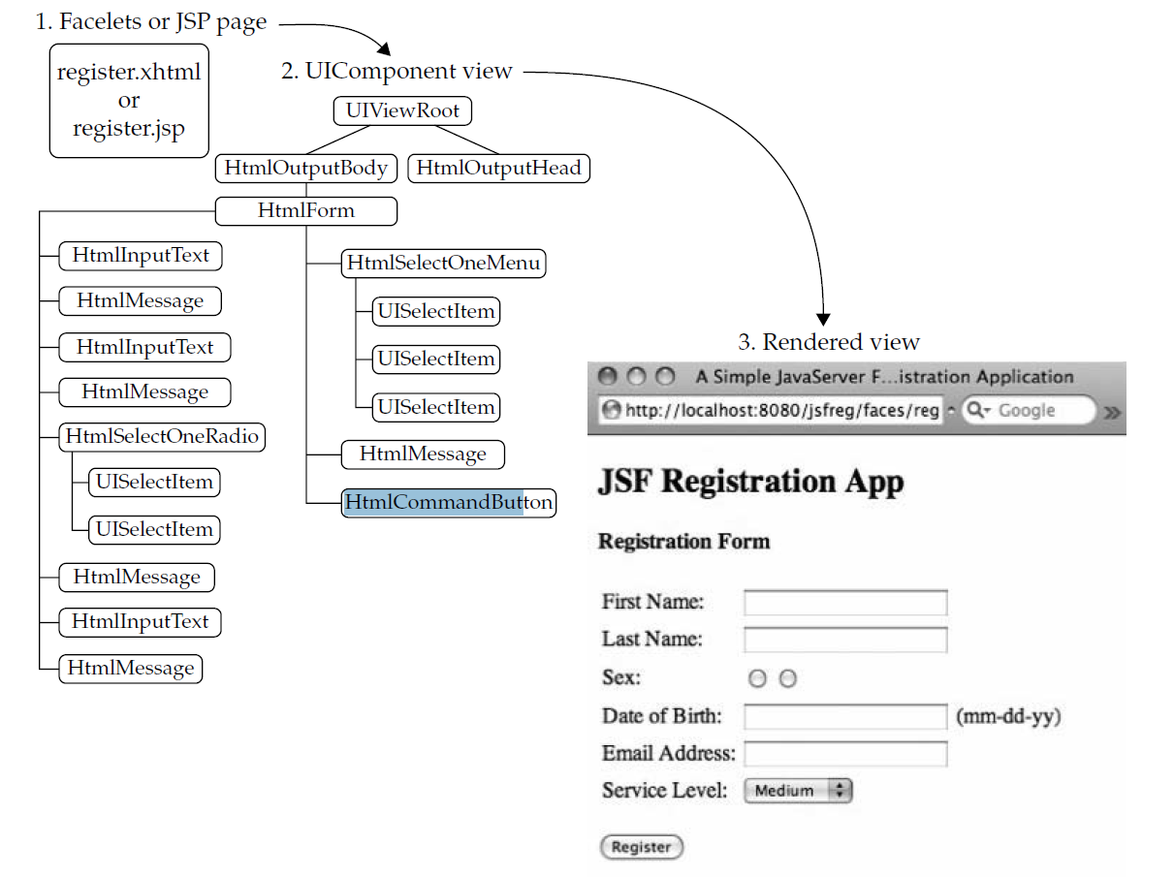
Phase 1 - Restore View
Notes:
JSF begins the restore view phase as soon as a link or a button is clicked and JSF receives a request.
During this phase, JSF builds the view, wires event handlers and validators to UI components and saves the view in the FacesContext instance. The FacesContext instance will now contain all the information required to process a request.

Slide 29
Apply Request Value
During this phase, the JavaServer Faces implementation builds the view of the page, wires event handlers and validators to components in the view, and saves the view in the FacesContext instance, which contains all the information needed to process a single request.
Initial request : JavaServer Faces implementation creates an empty view during this phase and the life cycle advances to the render response phase, during which the empty view is populated with the components referenced by the tags in the page.
Postback : View corresponding to this page already exists. During this phase, the JavaServer Faces implementation restores the view by using the state information saved on the client or the server.

Slide 30
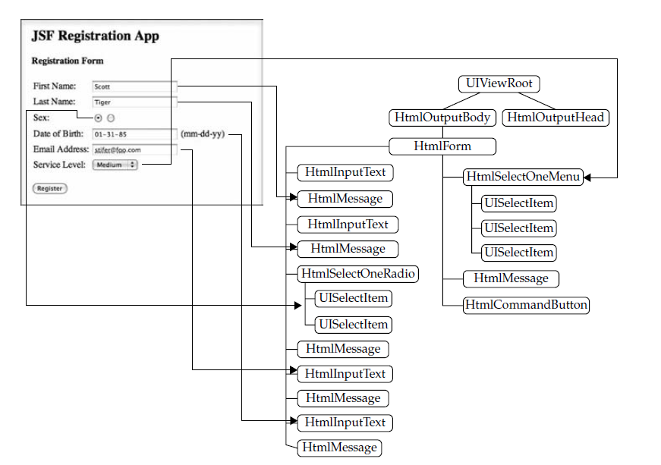
JSF Request Lifecycle
Phase 2 - Applying Request Value
Notes:
After the component tree is created/restored, each component in the component tree uses the decode method to extract its new value from the request parameters. Component stores this value. If the conversion fails, an error message is generated and queued on FacesContext. This message will be displayed during the render response phase, along with any validation errors.
If any decode methods event listeners called renderResponse on the current FacesContext instance, the JSF moves to the render response phase.

Slide 31
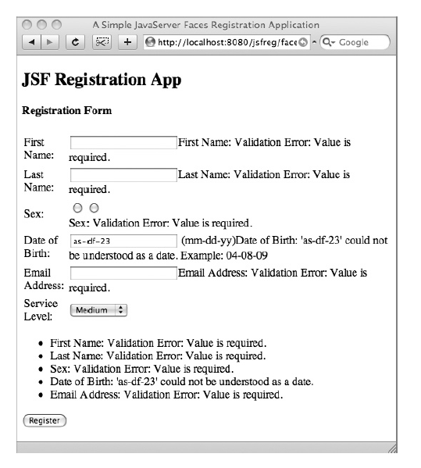
JSF Request Lifecycle
Phase 3 - Validations Process
Notes:
During this phase, JSF processes all validators registered on the component tree. It examines the component attribute rules for the validation and compares these rules to the local value stored for the component.
If the local value is invalid, JSF adds an error message to the FacesContext instance, and the life cycle advances to the render response phase and displays the same page again with the error message.

Slide 32
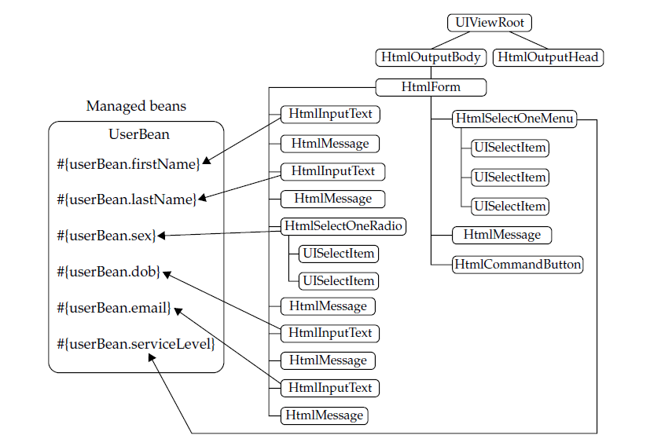
JSF Request Lifecycle
JSF Request Processing Lifecycle
Phase 4 - Update Model Values
Notes:
After the JSF checks that the data is valid, it walks over the component tree and sets the corresponding server-side object properties to the components' local values. JSF will update the bean properties corresponding to the input component's value attribute.
If any updateModels methods called renderResponse on the current FacesContext instance, JSF moves to the render response phase.

Slide 33
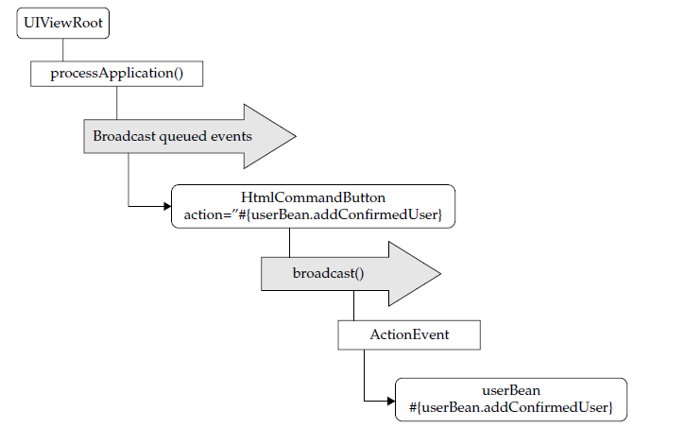
JSF Request Lifecycle
JSF Request Processing Lifecycle
Phase 5 - Invoke Application
Call business
#{userController.addConfirmedUser}
In charge of navigation
Notes:
During this phase, JSF handles any application-level events, such as submitting a form/linking to another page.

Slide 34
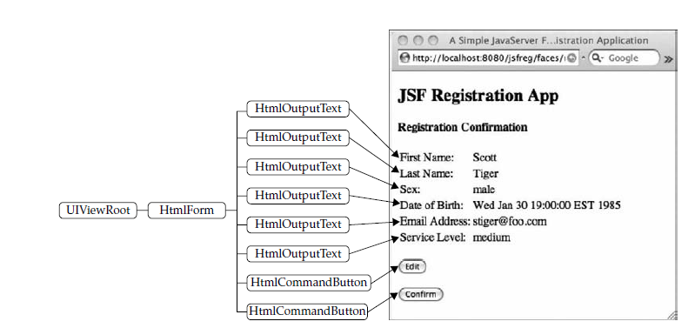
JSF Request Lifecycle
Phase 6 - Rendering Response
Notes:
During this phase, JSF asks container/application server to render the page if the application is using JSP pages. For initial request, the components represented on the page will be added to the component tree as JSP container executes the page. If this is not an initial request, the component tree is already built so components need not be added again. In either case, the components will render themselves as the JSP container/Application server traverses the tags in the page.

Slide 35
The Facelets (Pages, views)
Notes:
Faire la difference entre facelets et facet (vue et sous composant)

Slide 36
The Facelets View
Provide a server-side templating facility that allows composing the actual view from several separate physical pages in a way that maximizes markup code reuse and eliminates redundancy among views.
Provide an extensible “tag library” feature.
Enforce clean Model-View-Controller separation by disallowing the inclusion of Java code in markup pages.
Notes:
In computing, Facelets is an open-source Web template system under the Apache license and the default view handler technology (aka view declaration language) for JavaServer Faces (JSF). The language requires valid input XML documents to work. Facelets supports all of the JSF UI components and focuses completely on building the JSF component tree, reflecting the view for a JSF application.

Slide 37
Standard JSF TAGS
The most popular extension used for JSF pages, is XHTML
A JSF page is defined by a set of component and its tag libraries
Each component belongs to a specific Library defined by its namespace
3 main natives Libraries
xmlns:h="http://java.sun.com/jsf/html"
xmlns:ui= "http://java.sun.com/jsf/facelets"
xmlns:f ="http://java.sun.com/jsf/core"

Slide 38

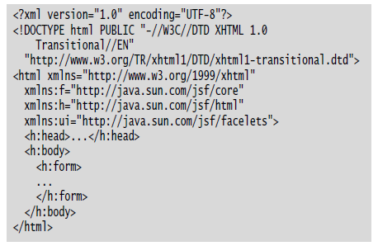
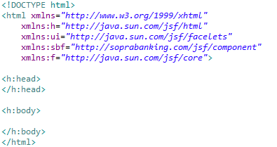
Facelets Page layout
TagLibs

Slide 39
Facelets Page layout (Template)
ui:insert:Used in template file. It defines contents to be placed in a template.
ui:define:Defines the contents to be inserted in a template.
ui:include:Includes contents of one xhtml page into another xhtml page.
ui:composition:Loads a template using template attribute. It can also define a group of components to be inserted in xhtml page.

Slide 40
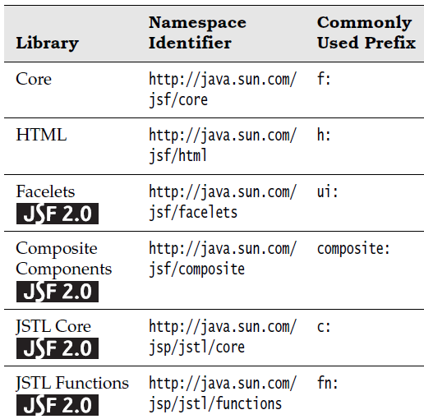
JSF Libraries Overview
All natives
Library | Namespace Identifier | Commonly Used Prefix
Core | http://java.sun.com/ jsf/core | f:
HTML | http://java.sun.com/ jsf/html | h:
Facelets | http://java.sun.com/ jsf/facelets | ui:
Composite Components | http://java.sun.com/ jsf/composite | composite:
JSTL Core | http://java.sun.com/ jsp/jstl/core | c:

Slide 41
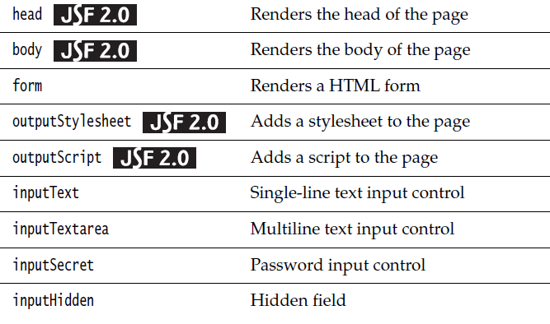
JSF HTML Library
xmlns:h="http://java.sun.com/jsf/html"
Tag | Description
head | Renders the head of the page
body | Renders the body of the page
form | Renders a HTML form
outputStylesheet | Adds a stylesheet to the page
outputScript | Adds a script to the page
inputText | Single-line text input control
inputTextarea | Multiline text input control
inputSecret | Password input control

Slide 42
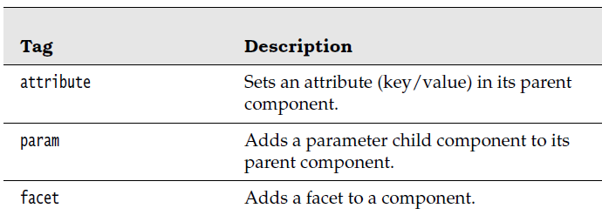
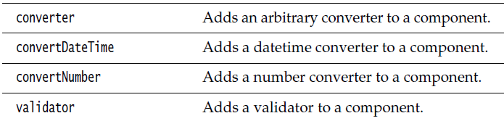
JSF Core Library
xmlns:f ="http://java.sun.com/jsf/core"
Tag | Description
attribute | Sets an attribute (key/value) in its parent component.
facet | Adds a facet to a component.
converter | Adds an arbitrary converter to a component.
convertDateTime | Adds a datetime converter to a component
convertNumber | Adds a number converter to a component.
validator | Adds a validator to a component.
validateLength | Validates the length of a component’s value.

Slide 43

Pratical Work
Facelets
JSF Lab 1

Slide 44
Managed Bean & Expression Language

Slide 45
What is a Managed Bean?
Java Objects that store application data
A POJO handled by a container (JSF) with a well-defined lifetime (scope)
Never have to manually call new( ) on a managed bean
Decouples the view technology from the domain model of the application
Managed beans are “lazily initialized” by the container at runtime, only when needed by the application

Slide 46
Scope HIERARCHY
Application
Session
View
Request
None

Slide 47
Managed Bean & EL
Managed Bean Scope
Automatic Scope Overview
JSF Page
Request Scope
Request
Redirection
or inclusion
Response
JSF Page
Client 1
Session Scope
Request
JSF Page
Response
Redirection
or inclusion
Request Scope
JSF Page
Application Scope
JSF Page
Request
Request Scope
Redirection
or inclusion
Response
JSF Page
Client 1
Session Scope
Request
JSF Page
Response
Redirection
or inclusion
Request Scope
JSF Page

Slide 48
How to link the JSF views and Managed Beans ? - EL
EL stands for Expression Language
Expression Language first appeared in JSP
EL is a language to link the view and the ManagedBeans

Slide 49
Expression Language
Its purpose
Scriptlet :
EL in JSF : #{myBean.attribute}
<%
com.beans.MyBean myBean = (com.beans.MyBean) request.getAttribute("myBean" );
if (myBean == null ){
myBean = new com.beans.MyBean();
request.setAttribute("myBean", myBean);
}
%>

Slide 50
Navigation

Slide 51
Implicit Navigation
The absolute minimum about JSF navigation
Components you can put in the page that cause navigation
h:commandButton,
h:commandLink
h:button
h:link
These components must include an action attribute (h:commandButton and h:commandLink)
Or outcome attribute (h:button and h:link).

Slide 52
Implicit Navigation
The absolute minimum about JSF navigation
The value of that attribute can either hard-coded into the page, or an EL expression that returns a String
If a page exists for the value of the attribute, that page will be navigated to when the component was pressed.
Otherwise, others rules can be added into the faces-config.xml

Slide 53
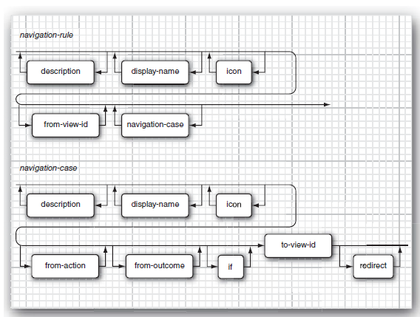
Advanced Navigation
Syntax Diagram for Navigation elements

Slide 54
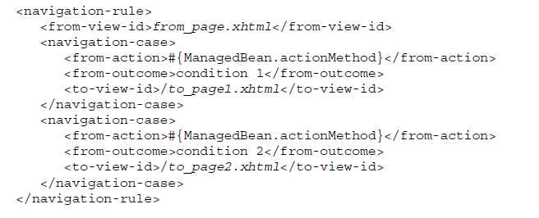
Advanced Navigation
Sample from Faces-Config.xml

Slide 55
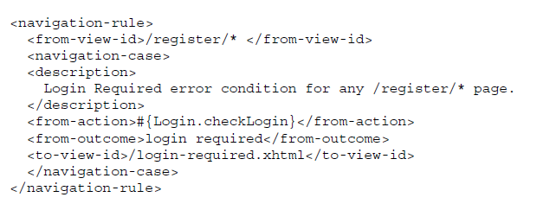
Advanced Navigation
Navigation
Using wildcard

Slide 56
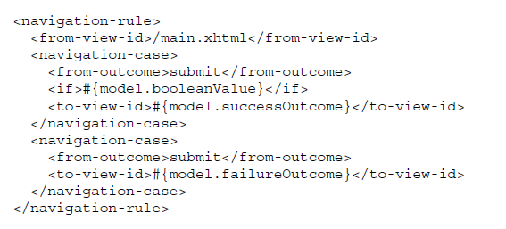
Advanced Navigation
Navigation
Using Conditional Navigation

Slide 57
Pratical Work
Navigation
JSF Lab 2

Slide 59
Legal disclaimer

